Slide 1



Talking futures
Parents’ careers
presentation
[DATE]
Supported by Gatsby

Slide 2

Welcome
What we’re going to cover
Introduction to education and careers options
How you can help your child make decisions that are right for them
The support we offer to help you and your child make decisions
Where you can find further information and support
Upcoming careers events and key contacts
Notes:
Provide a brief overview of the plan for the session to help attendees understand what to expect.
Introduce the idea that parents are one of the biggest influencers on students’ decisions which is why it’s critical for them to feel informed about the options themselves and understand how they can help their children.
Emphasise that your school/college is there to work with them and their child to provide information and support, so it is a joint effort to ensure that their child makes a decision that is right for them based on their strengths, interests, skills and aspirations.

Slide 3

Education and careers options
an overview

Slide 4
Post 16 options
What’s next?
Young people in England are required by law to stay in education or training until age 18.
There are a range of options available from apprenticeships to A-levels and in some parts of the country, you could do a new T-level qualification.
There is a lot to consider when making this decision - here is an overview of the options and things to things to think about.
Notes:
Reassure parents that they might find the landscape complicated and it’s ok to not have all the answers at this point – what’s most important is that they are keen to explore the options further and engage with the support available.

Slide 5
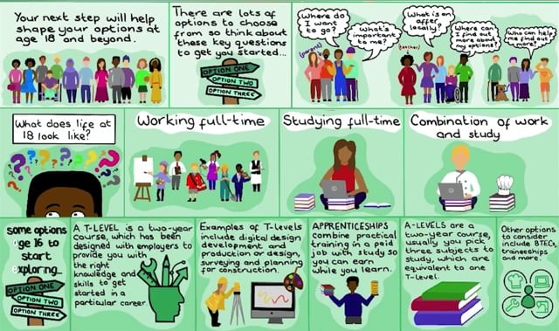
Post 16 options
Notes:
Share that this animation has been created by an artist to bring to life the options. It is just a very brief overview of the landscape but that further information is available on your school/college careers website and the Talking Futures website, and you’ll share this and other sources of information at the end of the presentation and in an email/letter/message home.
This film should play when clicked, alternatively it can be watched here:
https://www.talkingfutures.org.uk/resource/options-at-age-16-animation/
If you are working with a smaller group discuss any questions from parents at this point.

Slide 6
Post 16 options
What we offer
[add in here if you offer post 16 options]
Notes:
[Remember it is important to share details of all options locally available to your students, not just the routes on offer at your institution]

Slide 7
Post 16 options
Real-life insights
[add in here if you have case studies of alumni who have taken different post 16 routes or you could ask a range of local colleges, training providers or employers to speak about the options they offer]
Notes:
[If you are going to invite speakers to join ensure they represent a range of routes available and you may want to have some prompt questions to ask them all or just give them each a time slot to share their experiences/what they offer]

Slide 8
Post 18 options
What’s next?
In England, you don’t have to stay in education after the age of 18.
You can:
  Choose to go into employment.
  Do a short course of study to prepare you for a particular career.
  Go on to study a higher education qualification such as a Bachelor’s degree, HNC or foundation degree.
  Combine employment and training via an apprenticeship.
There is a lot to consider when making this decision - here is an overview of the options and things to things to think about.
Notes:
Reassure parents that they might find the landscape complicated and it’s ok to not have all the answers at this point – what’s most important is that they are keen to explore the options further and engage with the support available.
At this age their children may be keen to make decisions independently but ensuring they have considered all the options is important and helping them think about the long term implications of their choices can help ensure their decisions are well informed.

Slide 9
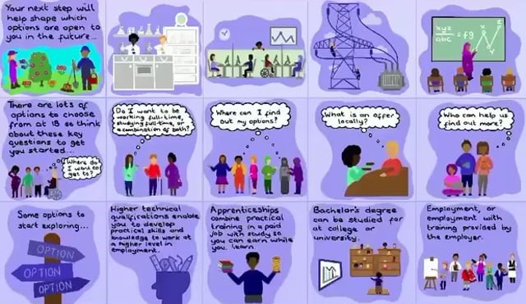
Post 18 options
Notes:
Share that this animation has been created by an artist to bring to life the options. It is just a very brief overview of the landscape but that further information is available on your school/college careers website and the Talking Futures website, and you’ll share this and other sources of information at the end of the presentation and in an email/letter/message home.
This film should play when clicked, alternatively – you can watch the video here:
https://www.talkingfutures.org.uk/resource/options-at-age-18-animation/
If you are working with a smaller group discuss any questions from parents at this point.

Slide 10
Post 18 options
What we offer
[add in here if you offer post 18 options or there are particular local opportunities you want to highlight to students]
Notes:
[Remember it is important to share details of all options locally available to your students, not just the routes on offer at your institution]

Slide 11
Post 18 options
Real-life insights
[add in here if you have case studies of alumni who have taken different post 18 routes or you could ask a range of local HE providers, training providers or employers to speak about the options they offer]
Notes:
[If you are going to invite speakers to join ensure they represent a range of routes available and you may want to have some prompt questions to ask them all or just give them each a time slot to share their experiences/what they offer]

Slide 12

Careers
decision-making
how can you help?

Slide 13
Supporting decision-making
How can you help?
As parents, you will have the opportunity to support your child’s decision making at several points in their education, and these decisions will impact their future career choices.
So how can you help them make decisions that are right for them?
    Talk regularly about careers, aspirations and interests as part of everyday conversation, not just at key decision-making points.
    Share your experiences, the choices you made and your skills with your child, whether you currently are in work, you are a full-time parent, you are seeking work or you are retraining.
    Encourage your child to be curious and work with them to research their options even if you don’t know the answers yourself.
Notes:
Emphasise that whilst the school/college plays a valuable role in supporting their child with information and guidance their role is key too. Holding regular and meaningful conversations with their child can help inform their thinking and help them see things from a different perspective. Reiterate that whatever their own path has been they will have valuable insights to share that could help their child’s decisions.

Slide 14
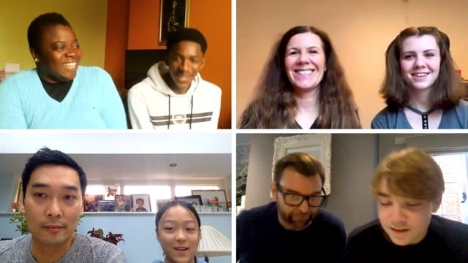

Supporting decision-making
Notes:
This film shows the important role parents can play and how conversations can be taken further to really explore their child’s interests and help shape their thinking about where that could lead next. It also shows how much a child can gain from learning more about their parent’s experiences.
If you’re working with a smaller group replay the film and pause after each family to discuss key points from their conversations.
The video should play when you click in the presentation. Alternatively it can be found here https://www.talkingfutures.org.uk/resource/family-conversations-film/

Slide 15

Careers
decision-making
how can we help?

Slide 16
The support we offer
Our careers programme
Consider inserting here:
    The careers programme planned for that year group, plus a snapshot of the whole institution programme so parents can see the long term support available (where applicable include your virtual offer)
    An explanation of/examples of your careers programme name or branding so parents know what to look out for on leaflets, presentations and letters that come home
Notes:
For visual examples of how to do this try using CEC’s roadmap templates for schools, colleges and SEND provision - https://resources.careersandenterprise.co.uk/resources/journeyroadmap

Slide 17
The support we offer
Who can help you and your child
Consider inserting here:
    An introduction to key staff that they can talk to about their child’s options including the Careers Leader and Careers Adviser(s), plus the role form tutors and subject teachers play
    It can make it more personal to include a little bio and photo of each member of staff involved in careers provision

Slide 18
The support we offer
Information we provide
Consider inserting here:
    What information is provided by the school/college and where to find it including website, careers page/portal, LMI tools, paid for services bought into by the institution that parents can access, any information provided by partner organisations and employers

Slide 19
The support we offer
How we develop our programme
Consider inserting here:
    How your institution captures student and parent feedback about careers, when parents can feed in their thoughts and how this informs planning

Slide 20
Careers
decision-making
finding further information

Slide 21
Exploring the options further
Using Talking Futures
Talking Futures has a range of resources to help you do further research and develop your careers conversations:
Activities to try at home include:
  Creating a family action plan to map out what you will do to explore the different options.
  Supporting your child to complete a pathway planner to help them to consider all the decisions they need to make and who they need support from.
  A conversation starter activity to prompt your discussions with your child.
Resources and information including the films you’ve seen in this session plus more information on the routes available and external sites that can provide more detail.
www.talkingfutures.org.uk/parents/

Slide 22
Exploring the options further
Sites to try for more information
nationalcareers.service.gov.uk
apprenticeships.gov.uk
tlevels.gov.uk
[insert locally relevant sites/ paid for services offered by the school/college]

Slide 23
Careers
decision-making
what next?

Slide 24
What next?
Upcoming careers events
Consider inserting here:
The next activity they can attend
The next activity their child will be taking part in
[If this is being run as an introduction to another activity at this point you can explain what’s coming up next at the event and how this introduction relates to the wider session plan]

Slide 25
Got questions?
You can contact
Consider inserting here:
Details of the Careers Leader
Details of the Careers Adviser
Details of any support services you offer more widely

Slide 26
Thank you

